Slide 1
Uncovering Immune Dysregulation in SLE through RNA-Seq of CD4⁺ T Cells
Parham Rouzbahani
ANGSD, Spring 2025

Slide 2
Introduction
Background
Systemic lupus erythematosus (SLE) is a complex autoimmune disease characterized by widespread inflammation and immune dysregulation.
CD4⁺ T cells play a central role in orchestrating immune responses and are known to be dysregulated in SLE
Transcriptomic profiling of these cells can offer insights into disease-associated pathways and molecular signatures.
Project Goal
To analyze RNA-seq data from CD4⁺ T cells of SLE patients and healthy controls
To identify differentially expressed genes and enriched biological processes involved in SLE pathogenesis.

Slide 3
Introduction (cont’d)
Dataset Source: Publicly available RNA-seq data from GEO accession GSE97263
Cell Type: Isolated CD4⁺ T cells from peripheral blood
14 healthy controls
13 SLE patients
RNA-seq Platform: Illumina HiSeq 2500
TruSeq Stranded mRNA HT kit (Illumina)
Paired-end reads (2 × 100 bp)
Library Preparation:
Poly-A selection to enrich for mRNA
cDNA synthesis and Illumina-compatible adapter ligation
PCR amplification and quality assessment using Bioanalyzer
Source: Shen et al., Nature Communications (2021) “Type I interferons affect the metabolic fitness of CD8⁺ T cells from patients with systemic lupus erythematosus” [DOI: 10.1038/s41467-021-22436-z]

Slide 4
Hypothesis
CD4⁺ T cells from patients with systemic lupus erythematosus (SLE) exhibit distinct transcriptional signatures compared to healthy controls, characterized by differential gene expression in immune-related pathways, including type I interferon signaling
Source: Postal, M., Vivaldo, J. F., Fernandez-Ruiz, R., Paredes, J. L., Appenzeller, S., & Niewold, T. B. (2020). Type I interferon in the pathogenesis of systemic lupus erythematosus. Current opinion in immunology, 67, 87–94. https://doi.org/10.1016/j.coi.2020.10.014

Slide 5
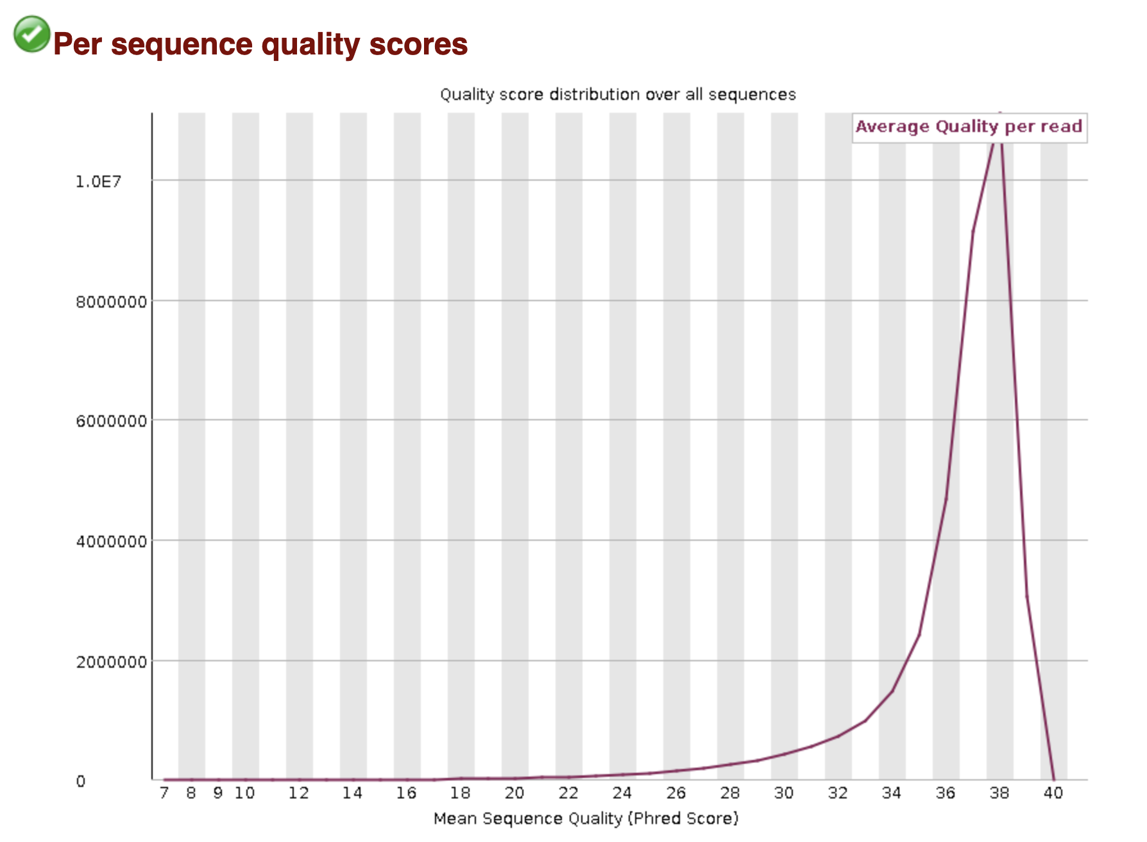
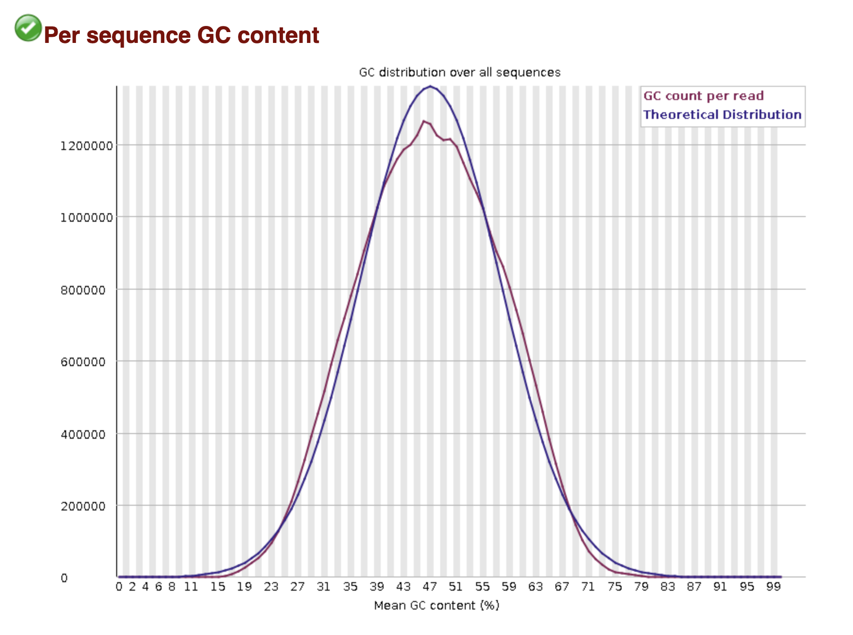
Pre-Processing and QC: FastQC

Slide 6
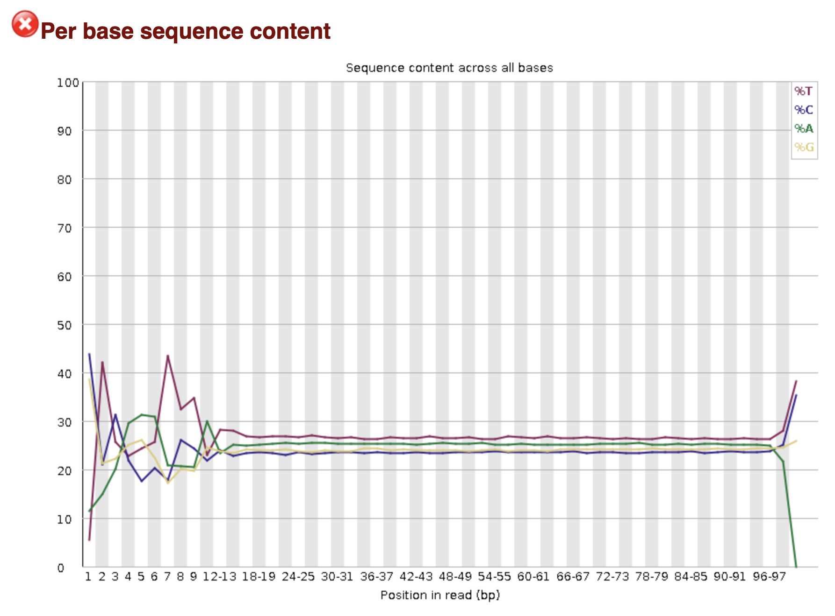
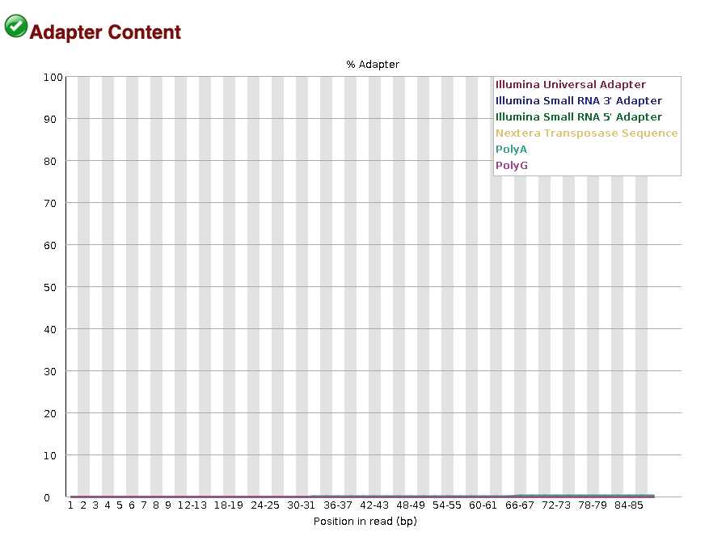
Pre-Processing and QC: FastQC (cont’d)
Notes:
Expected in RNA-seq data due to biases introduced during random priming and fragmentation in library preparation

Slide 7
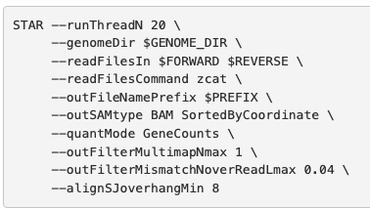
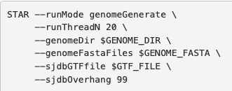
Pre-Processing and QC: STAR Alignment
Used STAR (Spliced Transcripts Alignment to a Reference) for fast and accurate alignment of paired-end reads.
Genome index built using GENCODE v47 annotation and GRCh38 primary assembly.
Notes:
--quantMode GeneCounts: This parameter instructs STAR to perform basic gene-level quantification during the alignment step. File reports raw read counts for each gene across four columns: the first column lists the gene ID, followed by counts assuming unstranded data, counts for strand-specific data (forward strand), and counts for strand-specific data (reverse strand). STAR quantifies reads by overlapping aligned reads with exonic regions defined in the provided GTF annotation file.
--outFilterMultimapNmax: This is a highly stringent filter that only retains reads mapping to a single genomic location. Any read that maps to more than one locus (even just two) is discarded. This can lead to the exclusion of legitimate reads that align to homologous genes, but ultimately I prioritized unambiguous, high-confidence alignments for clearer downstream interpretation. Gene families, pseudogenes, or paralogs
--outFilterMismatchNoverReadLmax: Discards reads with more than 4% mismatches relative to their length.

Slide 8
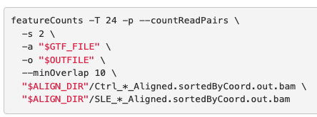
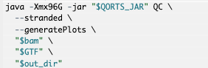
Pre-Processing and QC: QoRTs & featureCounts
Used QoRTs QC on STAR-aligned BAM files using GENCODE v47 GTF
Used featureCounts to generate gene-level raw counts for differential expression analysis
Notes:
--countReadPairs: Ensures only properly paired reads are counted as a fragment. This avoids double-counting each end of a pair
--s 2: Indicates the data is stranded and in reverse orientation (appropriate for TruSeq Stranded mRNA kits).

Slide 9
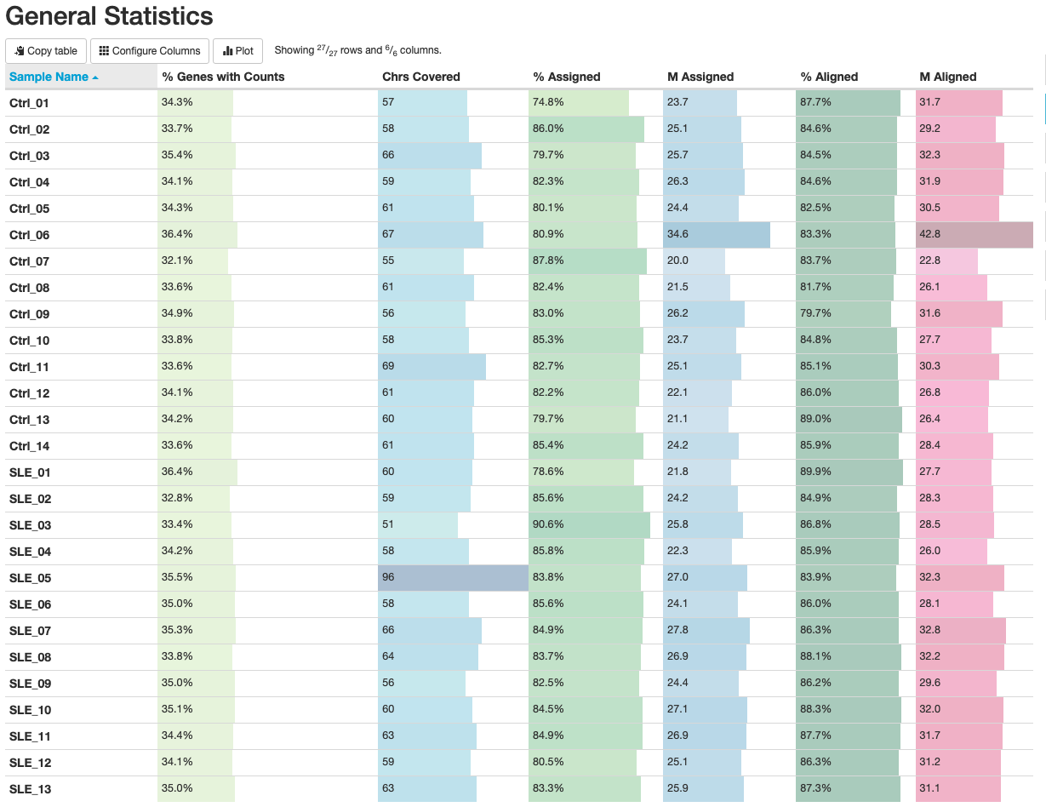
Pre-Processing and QC: MultiQC
Used MultiQC to aggregate output from multiple bioinformatics tools into a single, interactive HTML report
High alignment quality: Most samples show % Assigned between 70–85%, indicating accurate transcript quantification
Broad genome coverage: All samples span over 50 chromosomes, reducing mapping bias.
Ctrl_06 stands out: It has much higher total reads—not a QC failure, but a result of deeper sequencing.
Slight variation in “% Genes with Counts”: Likely due to biological variability in expression rather than technical issues.

Slide 10
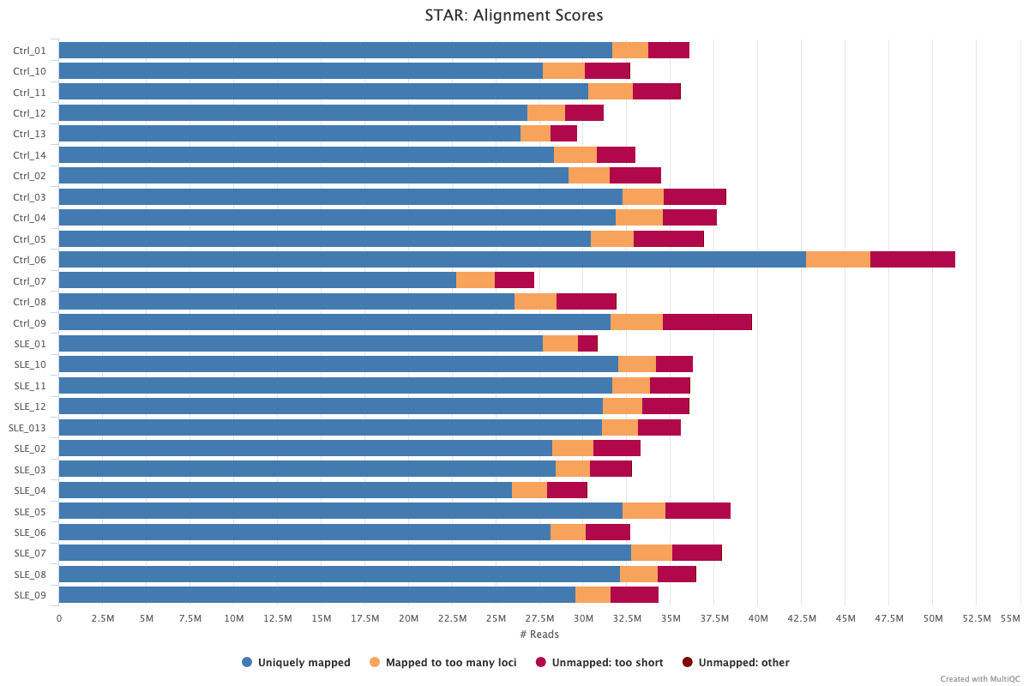
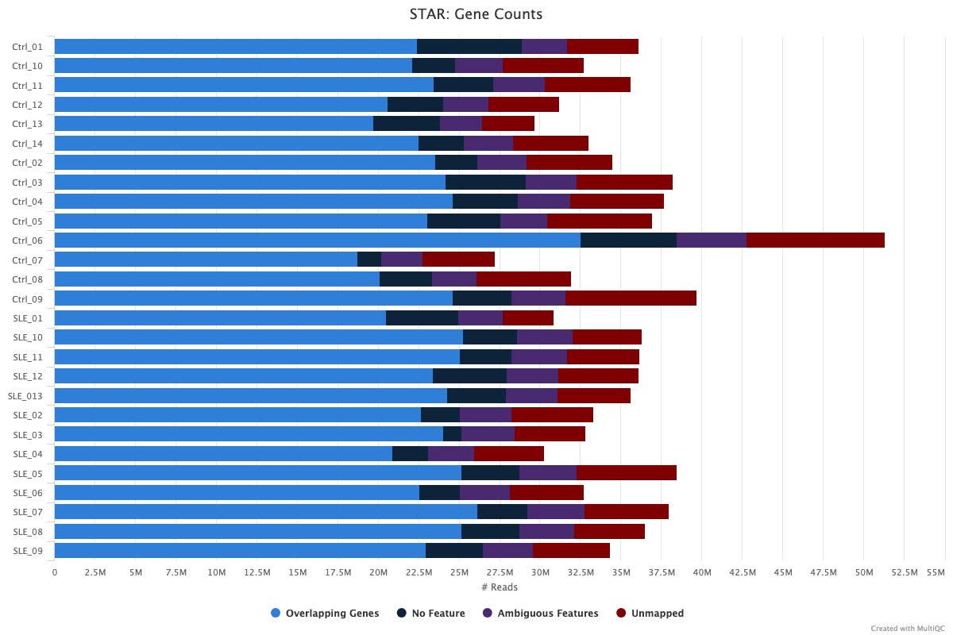
Pre-Processing and QC: MultiQC (cont’d)
Strong alignment performance: Most reads are uniquely mapped, a desired outcome in RNA-seq.
Low levels of unmapped/multimapped reads: Expected due to low-complexity regions or short fragments.
Ctrl_06 has higher absolute reads in all categories but maintains expected relative proportions.
No samples exhibit alignment issues that would warrant exclusion from downstream analysis.

Slide 11
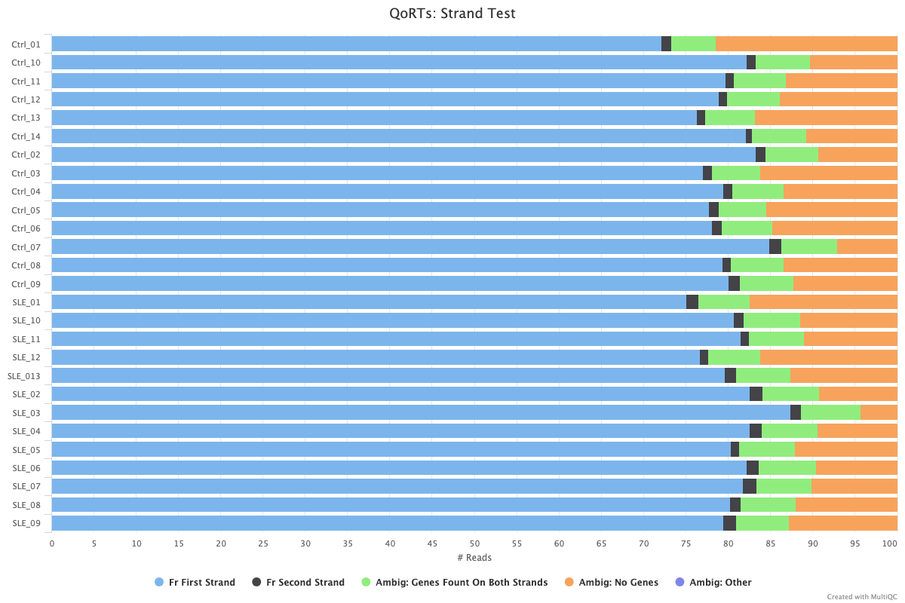
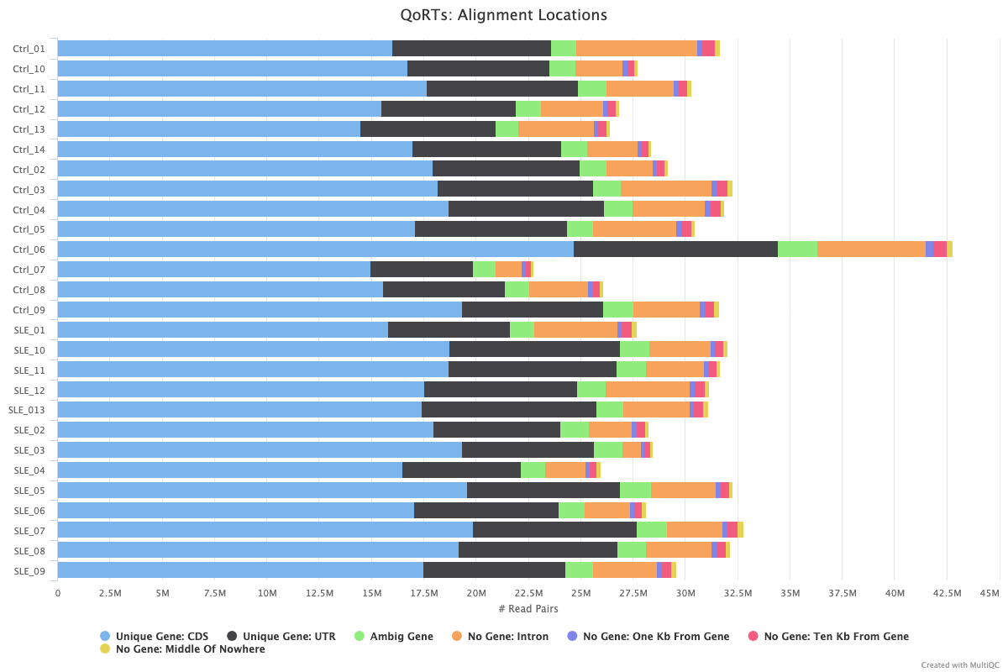
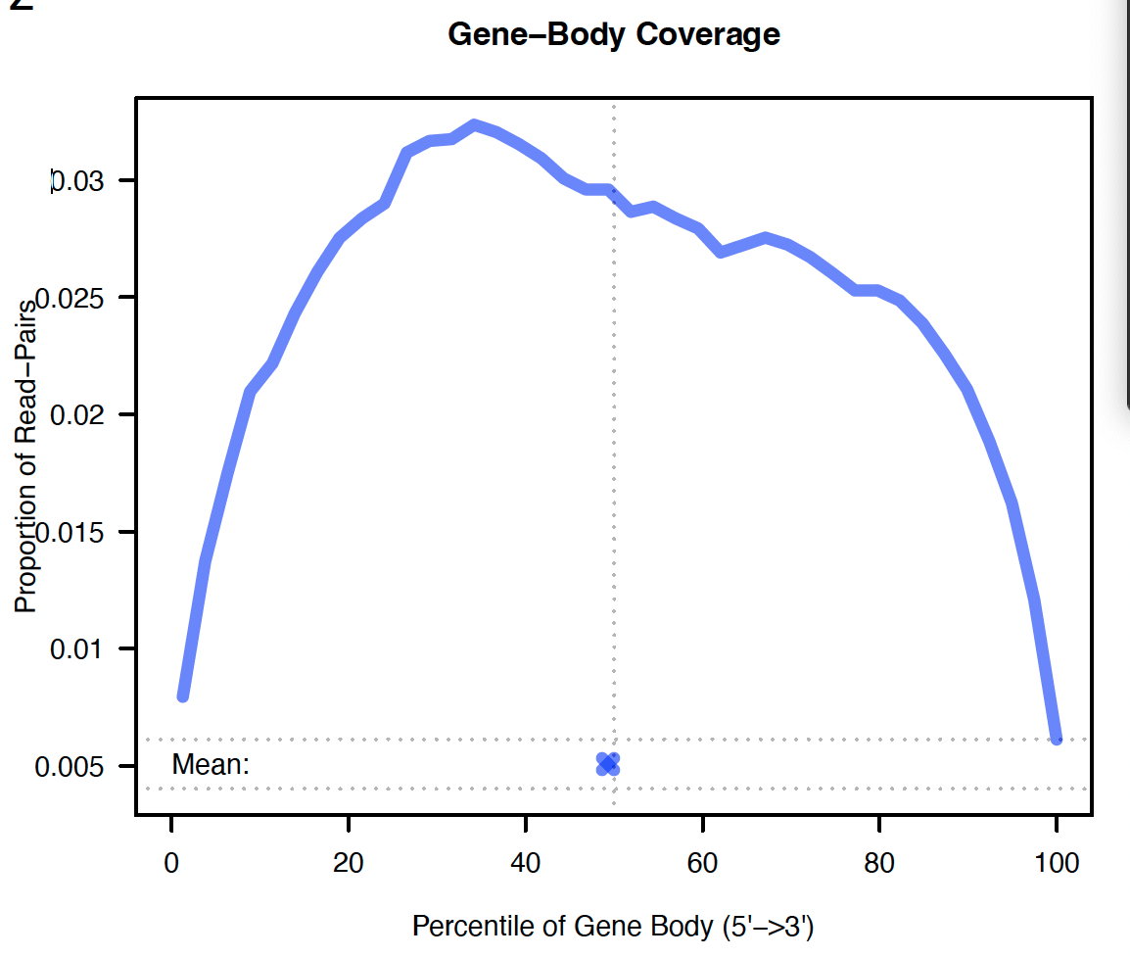
Pre-Processing and QC: MultiQC (cont’d)
Reads distribute as expected: Most align to cording regions and untranslated regions, with modest intronic/intergenic mapping
Strand specificity confirmed: All samples map predominantly to the expected reverse strand (fr-firststrand), validating the use of -s 2 in featureCounts
Gene body coverage shows RNA integrity and no significant 5′ or 3′ bias
Notes:
high proportions of reads mapping to coding regions (CDS) and untranslated regions (UTRs), with modest levels of reads aligning to intronic or intergenic regions

Slide 12
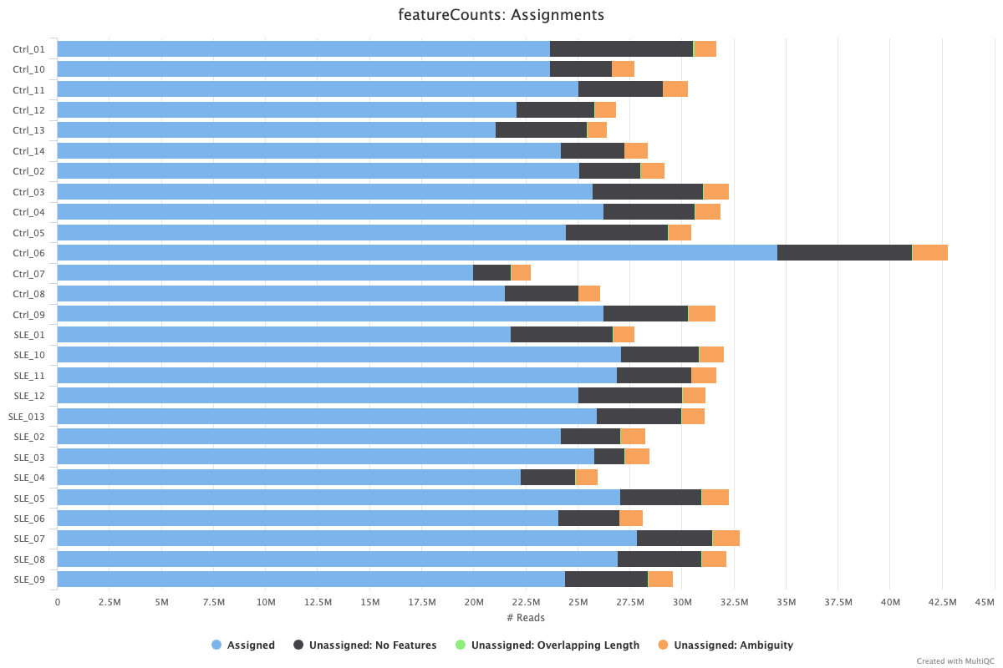
Pre-Processing and QC: MultiQC (cont’d)
Most reads successfully assigned: Dominant light blue bars indicate strong gene feature assignment across samples.
Minor unassignment categories: “No Features” and “Ambiguity” remain low to moderate, as expected.
Ctrl_06 has higher read counts, but its relative proportions are normal, not indicative of technical error.
High data quality overall: No sample shows major assignment failure
Notes:
The majority of reads in each sample were successfully assigned to annotated gene features

Slide 13
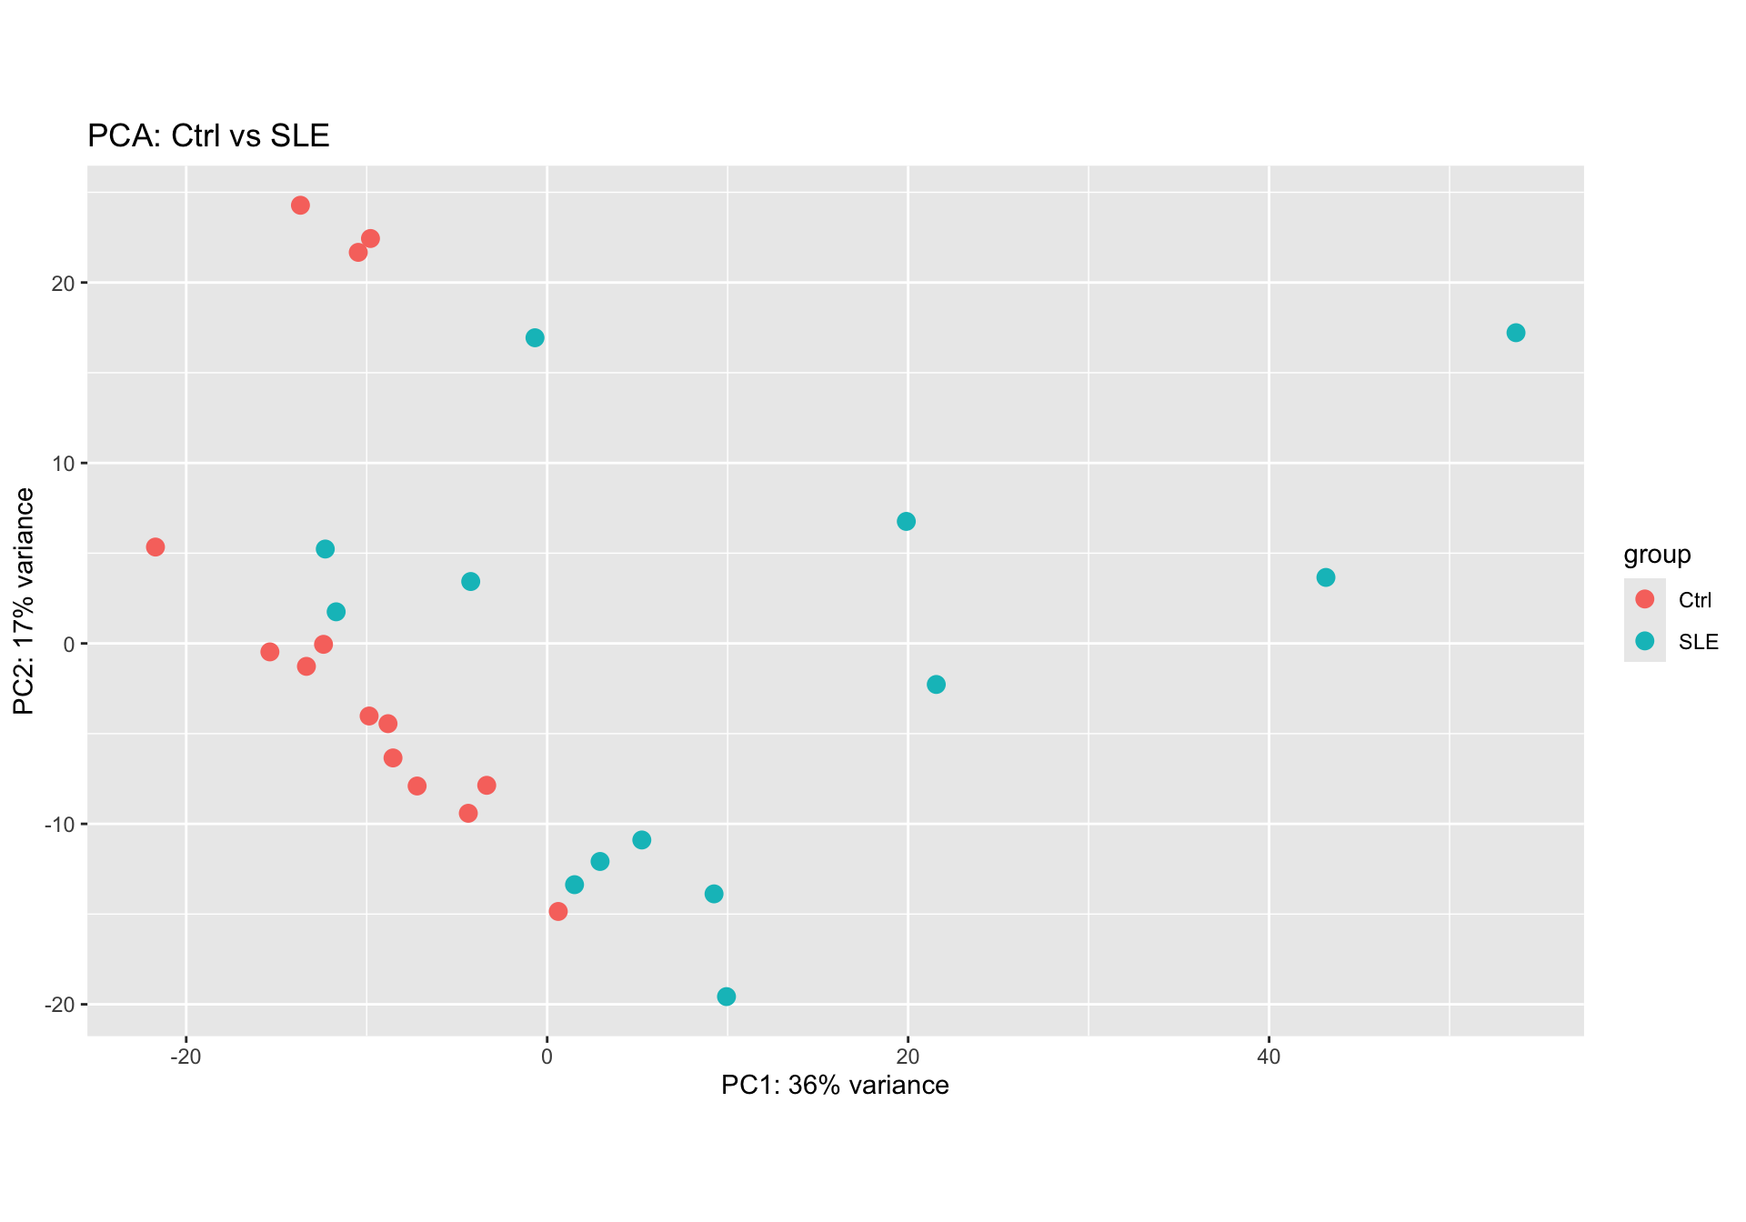
Differentially Expressed Genes Analysis: PCA
Preprocessed and normalized raw read counts
Read in txt file from featureCounts
Simplified file names, extracted condition metadata
Constructed a DESeqDataSet object
Applied rlog transformation for variance stabilization
Performed PCA (Principal Component Analysis)
Visualized global expression variation across samples.
PC1 and PC2 captured moderate variance (~30%) and showed some clustering by condition.

Slide 14
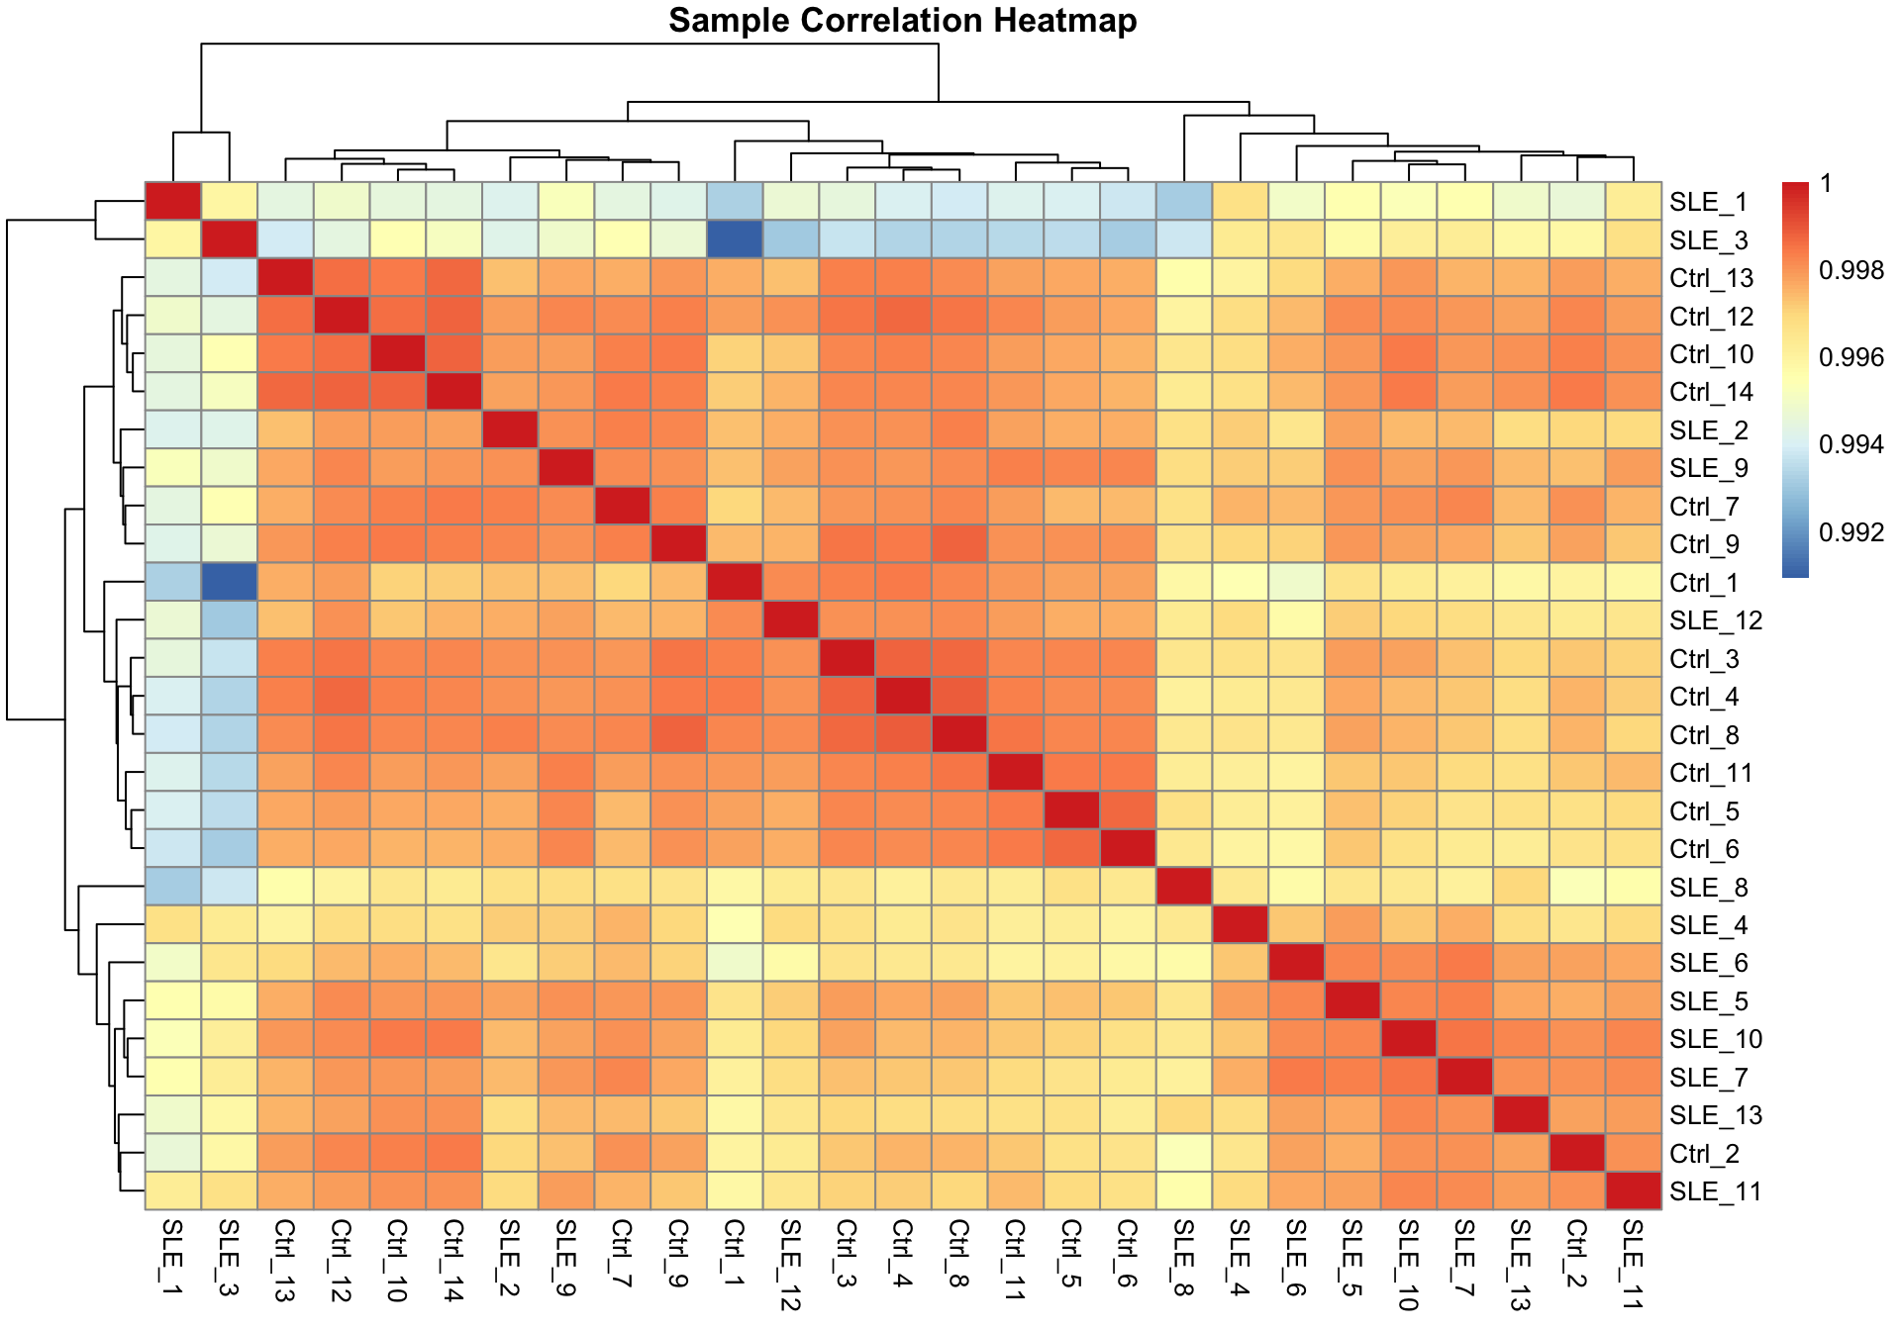
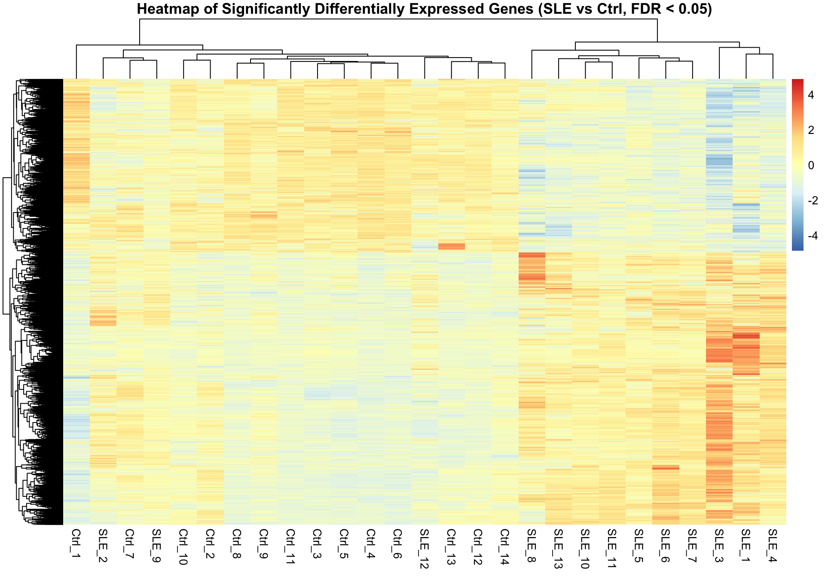
Differentially Expressed Genes Analysis: Heatmaps
Identified differentially expressed genes (DEGs) by using DESeq results method, adjusted p-value cutoff of 0.05
Analyzed sample correlation heatmap and differentially expressed genes heatmap (row-wise z-score normalization applied)

Slide 15
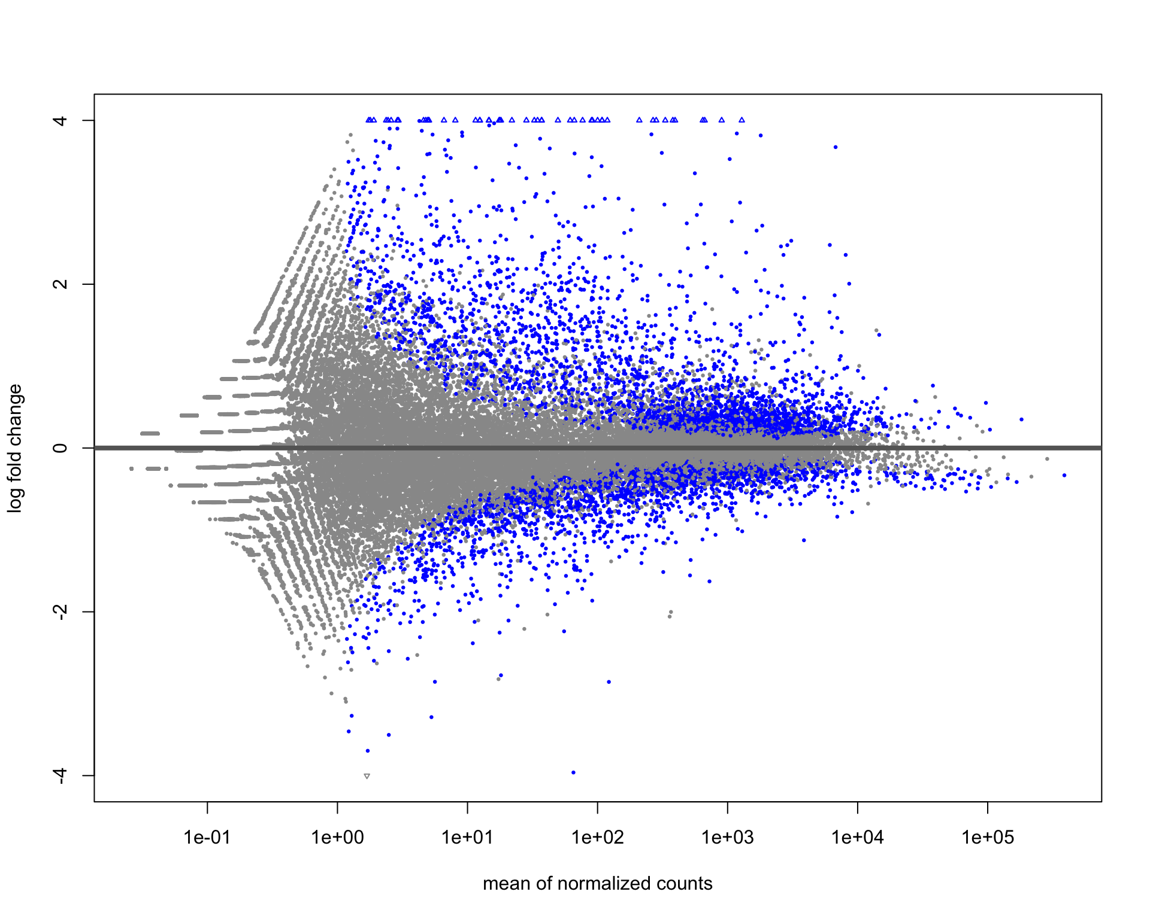
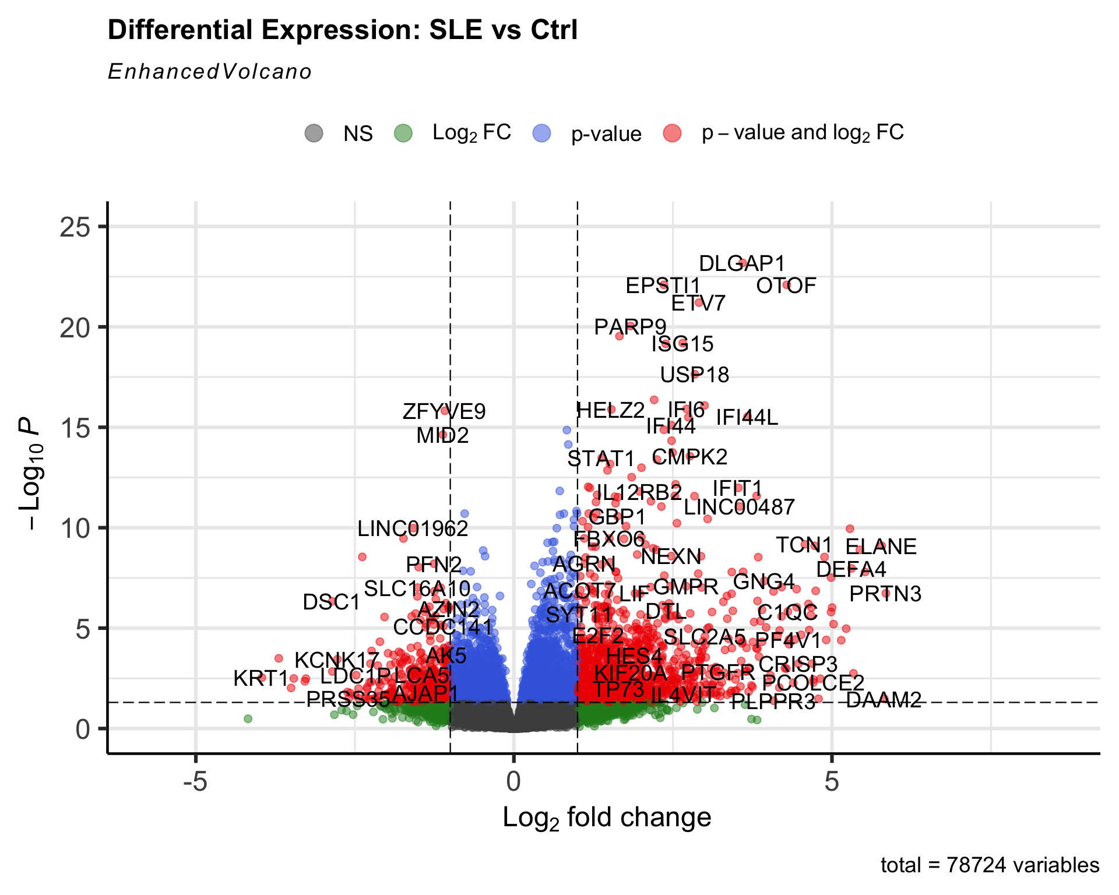
Differentially Expressed Genes Analysis: MA & Volcano Plots
Created MA and volcano plots to visualize DEGs and assess signal strength.
Notes:
Genes with both high statistical significance and large absolute fold change (in red) are the most biologically relevant. In this dataset, several upregulated genes stand out in the upper right quadrant—particularly interferon-stimulated genes (ISGs) such as ISG15, IFI44, IFI44L, USP18, and STAT1.

Slide 16
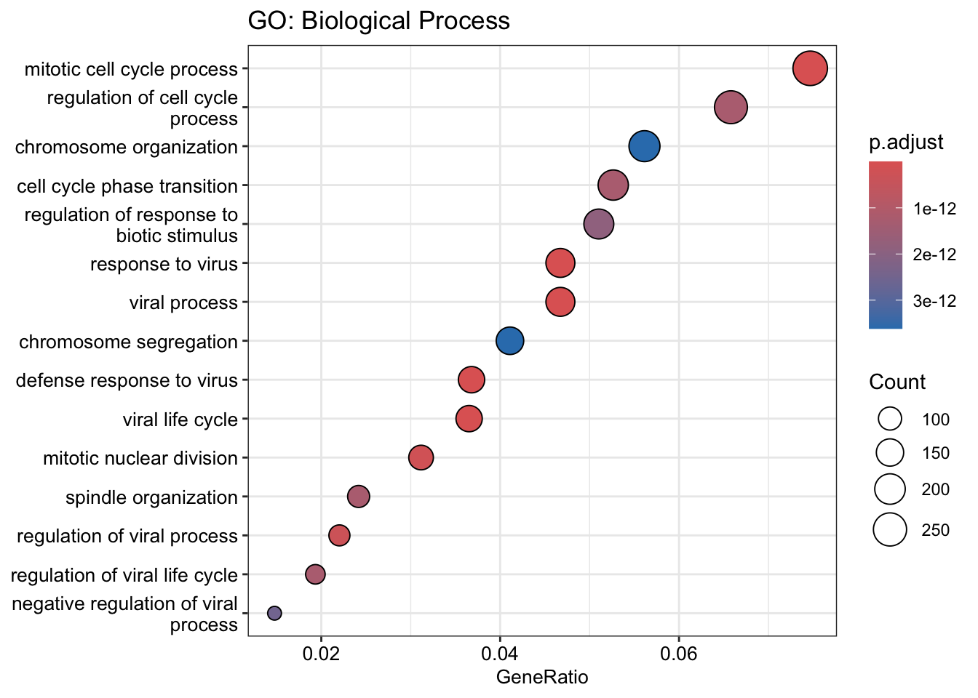
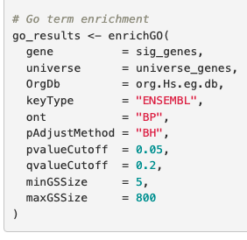
GO Term Enrichment
Filtered genes with adjusted p-value < 0.05 from DESeq2 results, used Biological Process ontology
922 enriched terms found
Found enrichment in type I interferon signaling, antiviral response, & immune activation pathways
Also observed enrichment in cell cycle regulation, suggesting proliferative shifts in CD4+ T cells
Analyzed using dotplot and revigo
Notes:
I used the Benjamini-Hochberg (BH) method to correct for multiple testing
qvalueCutoff = 0.2: I applied a more lenient q-value threshold of 0.2 to capture broader patterns that may be biologically relevant but marginally less significant. This is useful for exploratory analysis.
minGSSize = 5: I excluded GO terms with fewer than 5 associated genes to avoid inflated significance due to small set sizes.
maxGSSize = 800: I filtered out GO terms with more than 800 associated genes to prevent overly generic categories from diluting the interpretability of the results.
In addition, I observed increased activity in processes related to the cell cycle, like how cells prepare to divide and organize their chromosomes. This suggests that the CD4+ T cells in SLE patients might be dividing or growing in unusual ways..

Slide 17
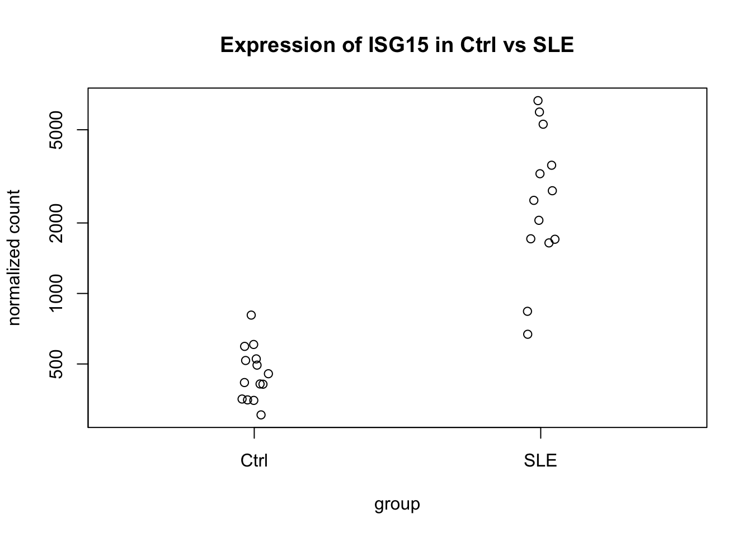
Expression of a GO-Enriched Gene in SLE vs Control

Slide 18
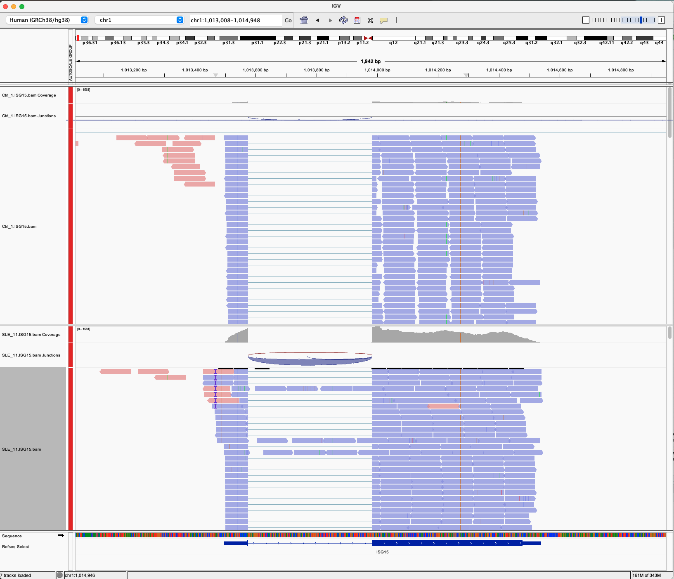
Expression of a GO-Enriched Gene in SLE vs Control

Slide 19
Challenges
Multimapping stringency in STAR
Used --outFilterMultimapNmax 1, which excludes reads with more than one alignment.
This is very conservative—may underestimate expression of genes with paralogs or repetitive regions.
Initial featureCounts run missed key flags
Forgot to include --countReadPairs and -s 2, leading to inflated counts and incorrect strand quantification.
These were fixed in a rerun after strand-specificity was confirmed with QoRTs.
Inconsistent sample naming and read depth variation
Required multiple rounds of renaming and normalization to address sequencing depth variability (e.g., Ctrl_06)
Sample size and no visibility on disease severity

Slide 20
Conclusion
Following alignment, QC, and quantification, I identified hundreds of significantly differentially expressed genes, many of which are involved in interferon signaling and immune response.
GO term enrichment confirmed type I interferon pathway activation and possible involvement of cell cycle regulation, both of which are known to play roles in SLE pathogenesis, supporting the hypothesis
Future directions
GSEA analysis
Subset by clinical metadata and different levels of disease activity or treatment
Isoform-level and splicing analysis (DEXSeq)
Cross-study comparisons
Integration with epigenomic datasets

Slide 21
Questions?

Slide 22
Thank you

